Slide 1
Managing Users and Jobs
Team or presenters name
Date: 26/05/2020
Location: DUB

Slide 2




Virtual Housekeeping
Use
Headsets
Go on
Mute
Participate Actively
Minimize Distractions
Notes:
***Please ensure you have your headset plugged in so we can avoid echoing and maintain audio quality
***Throughout the session, please keep your mic on mute to avoid background noise during the presentation portions.
***Please be aware you will be asked to participate and engage throughout the session. We ask that you are fully active in the chat box, and are also ready to be called on and unmute if needed. We’ll also have you click on some links to view videos, participate in polls and at some point during the session, we’ll be sending you to specific break out rooms depending on which service you’ll be shadowing.
***Lastly, we ask that you’re fully present. Keeping engaged is even more difficult in a virtual setting, so make sure you turn off notifications, maybe set an out of office in your email. Minimize distractions

Slide 3
Course objectives
adding/modifying/deleting users/groups/password
related system files
root and sudoers
job scheduling tools

Slide 4
Before we proceed, could everyone please launch an Amazon Linux 2 instance from the “Quick start” AMI’s for the practical exercises

Slide 5
managing users
useradd/adduser
usermod
id/finger/lslogins/who/w
passwd
userdel/deluser
/etc/passwd, /etc/shadow
Notes:
command for adding/modifying and deleting users
all changes are made to system files and can be read from them as well

Slide 6
managing groups
groupadd
groupmod
groupdel
groups
usermod –g <primarygroup> <user>
/etc/group

Slide 7
aging
Password expiration date
Command ‘chage’
/etc/shadow
Notes:
To disable password aging / expiration for a user, type command as follows and set: Minimum Password Age to 0 Maximum Password Age to 99999 Password Inactive to -1 Account Expiration Date to -1
# chage -I -1 -m 0 -M 99999 -E -1 username

Slide 8
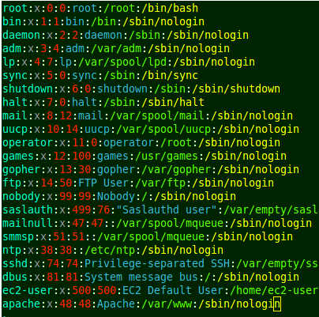
/etc/passwd
User name
Password
User ID
Group ID
Description
Home directory
Shell
Notes:
https://en.wikipedia.org/wiki/Passwd
1-User name: the string a user would type in when logging into the operating system: the login name. Must be unique across users listed in the file.
2-Information used to validate a user's password; in most modern uses, this field is usually set to "x" (or some other indicator) with the actual password information being stored in a separate shadow password file. Setting this field to an asterisk ("*") is a common way to disable direct logins to an account while still preserving its name.
3-user identifier number, used by the operating system for internal purposes. It need not be unique. can create Super-Users with uid =0 (root)
4-group identifier number, which identifies the primary group of the user; all files that are created by this user may initially be accessible to this group.
5-Commentary that describes the person or account. Typically, this is a set of comma-separated values including the user's full name and contact details.
6-Path to the user's home directory.
7-Program that is started every time the user logs into the system. For an interactive user, this is usually one of the system's command line interpreters (shells).

Slide 9
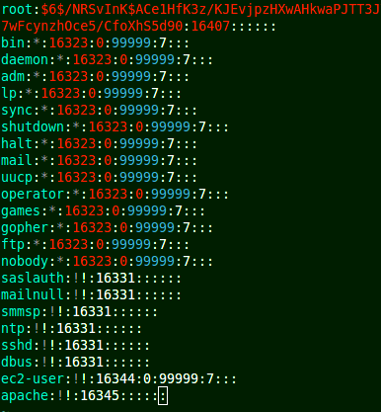
/etc/shadow
User name
Salt + hashed PW
Last changed
Minimum
Maximum
Warning
Inactive
Expire
Notes:
1-Username
2-Salt combined with the current hash of the user's password (usually produced from a cryptographic hash function)
"$id$salt$hashed“ -> root
* and ! -> Locked
!! -> No password set
3-Last password change (lastchanged): Days since Epoch (Jan 1, 1970) that password was last changed
4-Minimum: The minimum number of days required between password changes i.e. the number of days left before the user is allowed to change his/her password
5-Maximum: The maximum number of days the password is valid (after that user is forced to change his/her password)
6-Warn : The number of days before password is to expire that user is warned that his/her password must be changed
7-Inactive : The number of days after password expires that account is disabled
8-Expire : days since Jan 1, 1970 that account is disabled i.e. an absolute date specifying when the login may no longer be used

Slide 10
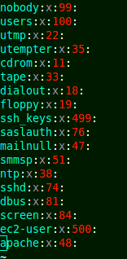
/etc/group
Group Name
Password
Group ID
Member List
Notes:
group_name:password:GID:user_list
1-Group Name: The name of group you get when run ls -l command.
2-Password: Generally password is not used, so it’s empty/blank. It can store encrypted password. This is useful to implement privileged groups.
3-Group ID (GID): Each user must be assigned a group ID. You can see this number in your /etc/passwd file.
4-Member List: It is a list of user names separated by commas of users who are members of the group

Slide 11
Exercise 1: Adding/Deleting Users
Add three users; Alice, Bob and Eve
Create password for Bob only
Observe /etc/passwd
Observe /etc/shadow
Delete user Alice
Notes:
adduser Alice
adduser Bob
adduser Eve
sudo passwd Bob
grep -i 'Alice\|Bob\|Eve' /etc/passwd
grep -i 'Alice\|Bob\|Eve' /etc/shadow

Slide 12
Exercise 2: Working with groups
Create group called ‘admins’
Add Bob to this admins group
Observe /etc/group
Delete admins group
Observe /etc/group
Notes:
groupadd admins
usermod –a –G admins Bob
grep -i admins /etc/group
delgroup admins
grep -i admins /etc/group
User can also be added to group at user creation:
sudo adduser UserName groupName

Slide 13
bash profile
configuration file depends on type of shell
interactive login shells are for example shells via ssh
interactive non-login shells are when opening a new terminal
interactive login shells use
/etc/profile (system-wide)
then in order:
~/.bash_profile, ~/.bash_login, and ~/.profile
interactive non-login shells are using ~/.bashrc only
Notes:
man bash
interactive login shell: You log into a remote computer via, for example ssh. Alternatively, you drop to a tty on your local machine (Ctrl+Alt+F1) and log in there.
interactive non-login shell: Open a new terminal.
non-interactive non-login shell: Run a script. All scripts run in their own subshell and this shell is not interactive. It only opens to execute the script and closes immediately once the script is finished.
non-interactive login shell: This is extremely rare, and you're unlikey to encounter it. One way of launching one is echo command | ssh server. When ssh is launched without a command (so ssh instead of ssh command which will run command on the remote shell) it starts a login shell. If the stdin of the ssh is not a tty, it starts a non-interactive shell. This is why echo command | ssh server will launch a non-interactive login shell. You can also start one with bash -l -c command.

Slide 14
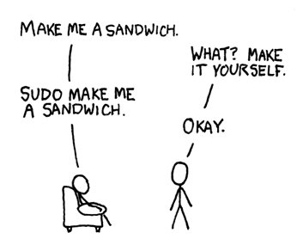
sudo and sudoers
Allow user to run command with root privileges
User must be included in the sudoers group
Edit sudoers settings file ONLY with visudo, as it checks syntax. In EC2: $ sudo visudo -f /etc/sudoers.d/cloud-init
The user must log off, for changes to take effect.
Notes:
Try to list the /root folder as normal user (ls –lah /root)
How to add a user to Sudoers?
$ sudo visudo (only use this to edit sudoers file as syntax is checked, editing the file directly will cause issues if syntax is wrong)
/etc/sudoers
#In EC2:
$ sudo visudo -f /etc/sudoers.d/cloud-init
Or in more recent AMIs:
$ sudo visudo -f /etc/sudoers.d/90-cloud-init-users
The user must log off, then back on again for this change to take effect.

Slide 15
sudo and sudoers
Can also enable sudo privileges by adding users to certain groups depending on linux distribution
#add an existing user to 'sudo' group in ubuntu/debian.
sudo usermod -a -G sudo userloginname
#add an existing user to 'wheel' group in RHEL/Centos/Amazon Linux.
sudo usermod -a -G wheel userloginname
Notes:
There can be groups mentioned in /etc/sudoers which specifies that any user in that group can run sudo commands, e.g:
## Allows people in group wheel to run all commands
%wheel ALL=(ALL) ALL
Adding users to these groups will then allow the users to have sudo priviledges
-a = append (if not specified it will be removed from any groups not listed in argument)
-G = list groups which you would like to add the user to

Slide 16
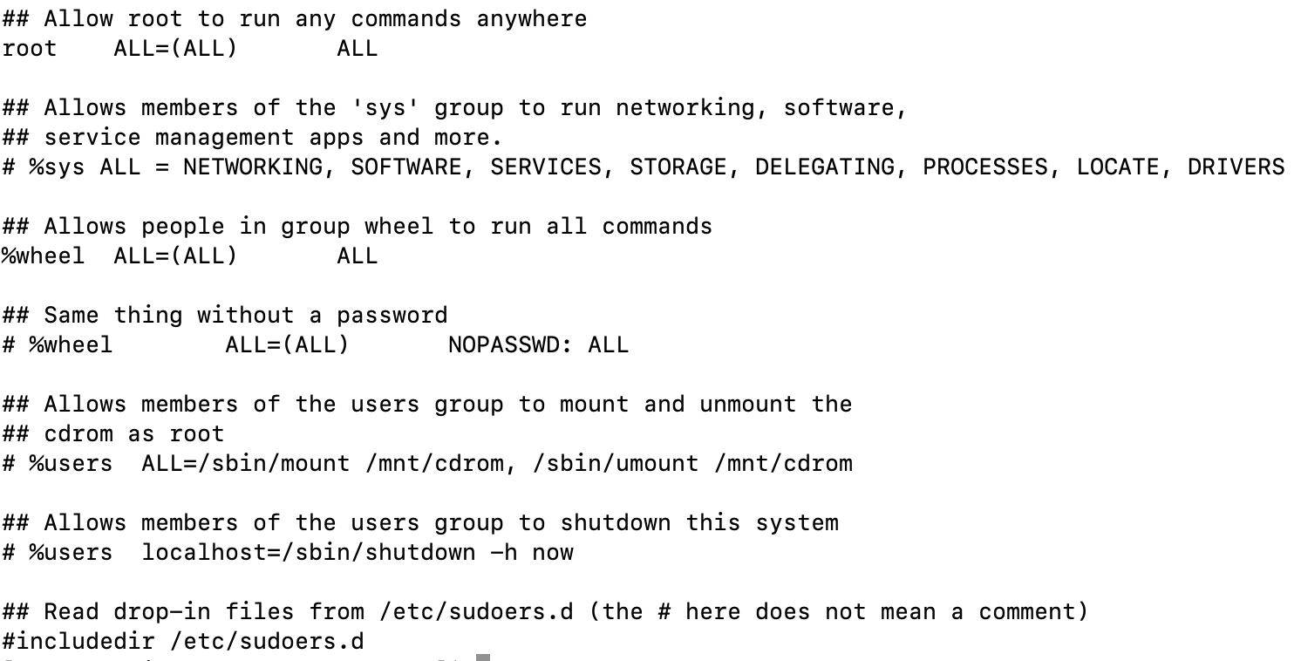
Sudoers file
Notes:
Located at /etc/sudoers
On AML2 ec2-user is given sudo privileges by default in /etc/sudoers.d/90-cloud-init-users
In /etc/sudoers in mentions includedir which points to /etc/sudoers.d/
[ec2-user@ip-172-31-11-140 ~]$ sudo grep includedir /etc/sudoers
#includedir /etc/sudoers.d
[root@ip-172-31-11-140 sudoers.d]# cat 90-cloud-init-users
# Created by cloud-init v. 19.3-43.amzn2 on Tue, 20 Apr 2021 16:41:41 +0000
# User rules for ec2-user
ec2-user ALL=(ALL) NOPASSWD:ALL

Slide 17
Exercise 3 : Grant sudo privileges
Grant sudo permissions by adding Bob to wheel group
Grant sudo permissions by adding Eve to sudoers file
Switch to user Bob and attempt sudo action
Switch to user Eve and attempt sudo action
Notes:
Adding Bob to wheel group:
sudo usermod -a -G sudo userloginname
Adding Eve to a sudoers file:
visudo -f /etc/sudoers.d/cloud-init
sudo visudo -f /etc/sudoers.d/90-cloud-init-users
visudo
Eve ALL=(ALL) NOPASSWD:ALL

Slide 18
users/groups nowadays
users do not log into the terminal server anymore to do their work
users and groups mostly used for administration
chage options very rarely used
direct root login discouraged

Slide 19
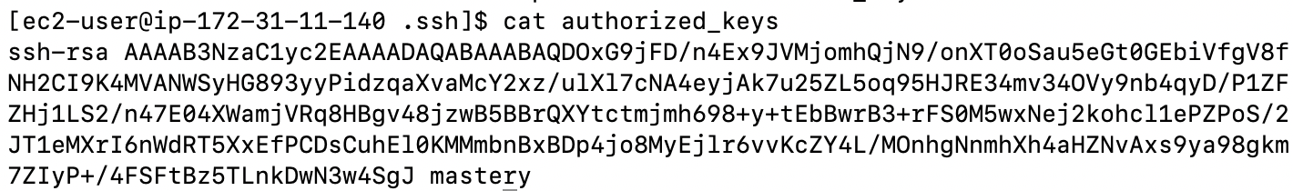
ssh and local users
SSH checks the certificate configured for the user
/home/ec2-user/.ssh/authorized_keys
^^^ Public key permissions must be -rw------- 600
check that the right user and format is used to connect
Create RSA Key Pair:
ssh-keygen -t rsa
Notes:
https://docs.aws.amazon.com/AWSEC2/latest/UserGuide/ec2-key-pairs.html

Slide 20
Enabling password authentication
By default on most AMIs, only key pair authentication is allowed
Once we create a password for a user we can modify ssh config to allow password authentication
/etc/ssh/sshd_config
#PasswordAuthentication yes
Not as secure as private key authentication

Slide 21
scheduling jobs
tasks/jobs that are supposed to run (more than once) at a specific time
cron (granular time configuration, repeats executions)
anacron (daily/weekly/monthly execution, for non 24/7 system)
at (single execution)
systemd timers (cron “replacement, only available in systemd systems)

Slide 22
cron
Components of cron:
crond (the daemon, typically started on boot)
crontab:
Table of scheduled jobs
Each user has its own crontab: /var/spool/cron/crontabs/username
There is a system crontab: /etc/crontab
crontab –e (edits user crontab)
crontab –l (list crontab jobs)
Crontab Fields:
Minute,Hour,Day of the month,Month,Day of the week, command
anacron in /etc/anacrontab
Notes:
Cron is use to schedule jobs periodically:
Backups
Rotate logs
Cron is aware of time changes. If we change the clock forward, cron will ensure the tasks are run, if we move the clock backwards cron will avoid the task run twice.
Crontab –e will edit the crontab for the user running the command. If we are root user we can edit an user’s crontab by running crontab –e –u username
Mention the most relevant crontab fields
There is additional configuration that can be done in the crontab, like setting environment variables :
SHELL=/bin/bash
PATH=/sbin:/bin:/usr/sbin:/usr/bin
MAILTO=root
HOME=
* * * * /opt/bin/mybackup.sh (every minute)
0 6,12 1 */2 * /opt/bin/mybackup.sh (runs at 6am and 10am on the 1st day of every 2 months
0 4 15-21 * 1 /opt/bin/mybackups.sh (runs at 4am on Mondays between 15 and 21 of each month
0 0-23/2 * * * /opt/bin/mybackups.sh (runs every day every 2 hours: at 2am, 4am, 6am
Notice:
We can specify ranges like 15-21 using “-”
We can specify several values separeced by “,” like 6,10
We can specify steps /2

Slide 23
crontab examples
# m h dom mon dow command
* * * * * /opt/bin/mybackup.sh
0 6,10 1 */2 * /opt/bin/mybackup.sh
0 4 15-21 * 1 /opt/bin/mybackups.sh
0 0-23/2 * * * /opt/bin/mybackups.sh
Notes:
* * * * /opt/bin/mybackup.sh (every minute)
0 6,12 1 */2 * /opt/bin/mybackup.sh (runs at 6am and 10am on the 1st day of every 2 months
0 4 15-21 * 1 /opt/bin/mybackups.sh (runs at 4am on Mondays between 15 and 21 of each month
0 0-23/2 * * * /opt/bin/mybackups.sh (runs every day every 2 hours: at 2am, 4am, 6am
Notice:
We can specify ranges like 15-21 using “-”
We can specify several values separeced by “,” like 6,10
We can specify steps /2

Slide 24

at
Run jobs at specific times (just once)
interactive mode via “at”
at –l to list
at –d to delete
at –f to schedule job
at –f mycommands.sh 10pm tomorrow
at –f mycommands.sh now + 5 hours
at –f mycommands.sh teatime
Notes:
which time is teatime?
4pm according to man at

Slide 25
systemd timers
systemd unit files whose name ends in .timer that control .service files or events
/etc/systemd/system/foo.timer:
[Unit]
Description=Run foo weekly and on boot
[Timer]
OnBootSec=15min
OnUnitActiveSec=1w
[Install]
WantedBy=timers.target
schedules foo.service
systemctl list-timers
Notes:
systemd timers are a type of unit file that is available in all systemd systems
upside:
integrates with already existing unit files in systemd
can be run independently of timer at any stage for easy debugging
downside: two files needed instead of one in cron
not well known
more info:
https://www.freedesktop.org/software/systemd/man/systemd.timer.html

Slide 26
Exercise 4: Scheduling a task
Restart the ssh daemon once at teatime

Slide 27
You should now be familiar with…
adding/modifying/deleting users/groups/password
related system files
root and sudoers
job scheduling tools

Slide 28
Insist on the highest standards
Please take 2 minutes to complete the survey to let us know what you liked about the training and what can be improved.
This will help us to continue creating helpful and relevant training content.
Link is in the invitation email.

